Slide 1
Meeting with Dr.Cao
09/2/26

Slide 2
Current Challenges
Not fully understand labview
Not be able to get actual signal
Not understanding the optical alignment the the equipment use in the system and the concept of it
For example pinhole, beam splitter, different type of transducer( impact the snr of the signal we get)The comprehensive of PAM system is not strong enough

Slide 3
Progress
Getting signal from oscilloscope, but it is noise
Reason did not put water
Trying to write the program in matlab version starting from aline
Be able to using the functional wave generator to trigger ;aser and getting signal from photodiode
Watch the video from jove (high speed ultraviolet photoacoustic microscopy for histological imaging with virtual staining assisted by deep learning)

Slide 4
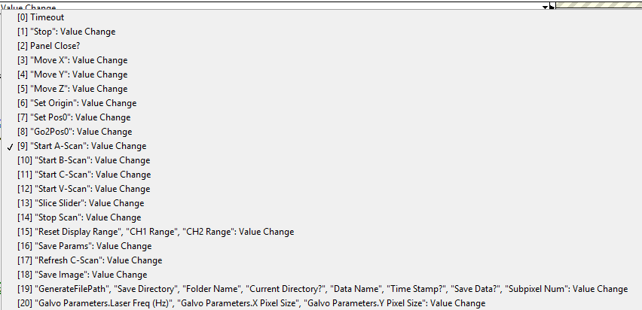
Plan
Starting to write code in matlab version
Reading the labview program
I want to start from move x move y and move z
Then from a scan to bscan

